Slide 1
ICS2O0 (Grade 10 Computer Science)
Mr. Nestor
(gregory.nestor@peelsb.com)
(p0079141@pdsb.net)

Slide 2
GitHub Introduction – Feb 06
Agenda
Attendance / Introductions
Module D.1 GitHub Introduction
Debrief: Level1
Level 2 & 3: Complete Today (Finish for Homework)
Email Mr. Nestor Link to Your Repository
Upload Answers to Your Repository
Upcoming
Past DUE: Module A.1 – Simon Game (Level 1 & 2)
Due Today: Complete Module D.1 (All Levels)

Slide 3
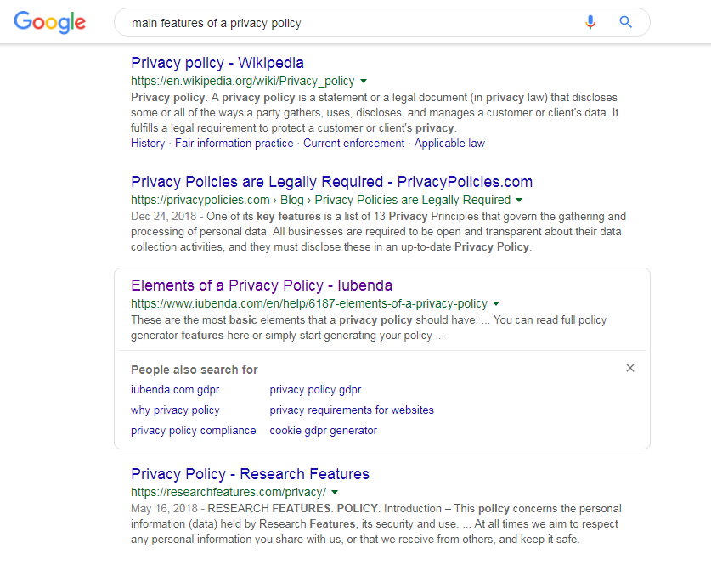
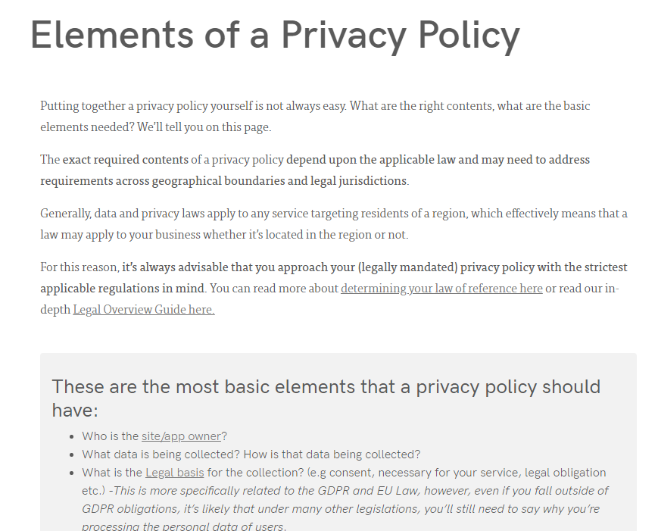
Searching For Answers
Ask Google a question:
“Main Features of a Privacy Policy”

Slide 4

Copy / Paste Answers
Preferred: Try to edit and rephrase in your own words.
Check for ideas or words that are above your grade level!
Sometimes: You may want to cut and paste directly.
Make sure your give credit to the source.
Either MPA or MLA

Slide 5


TOS vs. Privacy
Terms of Service
Written to Protect the Website
Not required by Law
What you are allowed to do
What will happen if you break the rules
Privacy Policy
Written to Protect You
Required by Law
How your Personal Info will be shared
How your Property Rights will be handled

Slide 6

Module D.1 – Key Expectations
Create your GitHub repository
Email the URL to Mr. Nestor
Organize your GitHub repository
Upload your answers to Module D.1

